Slide 1
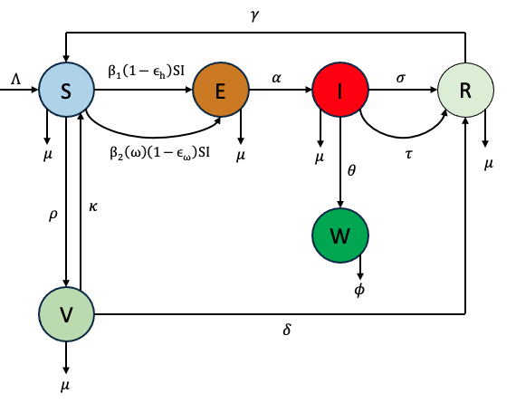
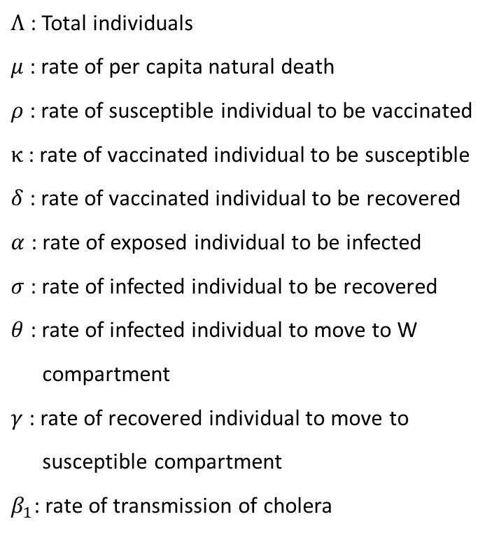

Description of model diagram
Parameters:
$Ʌ$ : Total individuals
$μ$ : rate of per capita natural death
$ρ$ : rate of susceptible individual to be vaccinated
$κ$ : rate of vaccinated individual to be susceptible
$δ$ : rate of vaccinated individual to be recovered
$α$ : rate of exposed individual to be infected
$σ$ : rate of infected individual to be recovered
$θ$ : rate of infected individual to move to W
compartment
$γ$ : rate of recovered individual to move to
susceptible compartment
$β_{1}$: rate of transmission of cholera
$β_{2}(ω)$: ??
$ε_{h}$: ??
$ε_{ω}$: ??
$τ$: ??
$φ$: ??
Figure 1. Schematic diagram of the cholera transmission model.
Compartments:
S : Susceptible individuals R : Recovery individuals
V : Vaccinated individuals
E : Exposed individuals
I : Infected individuals
W : What does w mean??

Slide 2
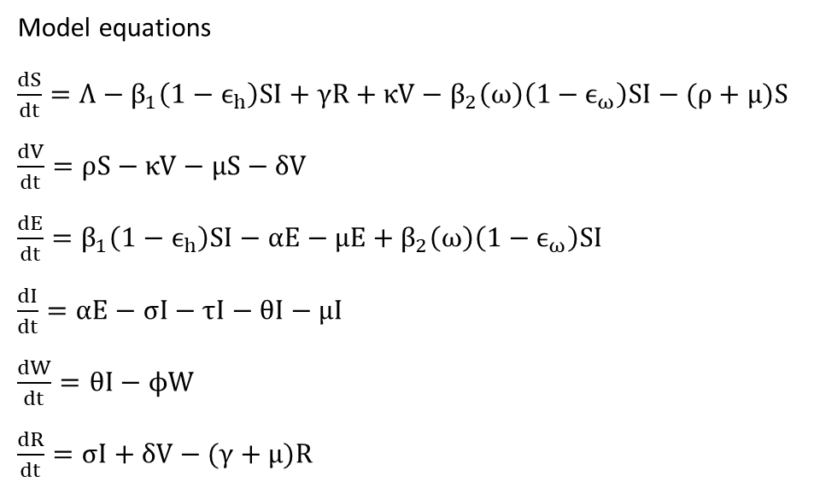
Model Equations
Model equations
$\frac{dS}{dt}=Λ−β_{1}\left(1−ϵ_{h}\right)SI+γR+κV−β_{2}\left(ω\right)\left(1−ϵ_{ω}\right)SI−(ρ+μ)S$
$\frac{dV}{dt}=ρS−κV−μS−δV$
$\frac{dE}{dt}=β_{1}\left(1−ϵ_{h}\right)SI−αE−μE+β_{2}\left(ω\right)\left(1−ϵ_{ω}\right)SI$
$\frac{dI}{dt}=αE−σI−τI−θI−μI$
$\frac{dW}{dt}=θI−ϕW$
$\frac{dR}{dt}=σI+δV−(γ+μ)R$

